Slide 1


Flutter Intro
József Lurvig

Slide 2

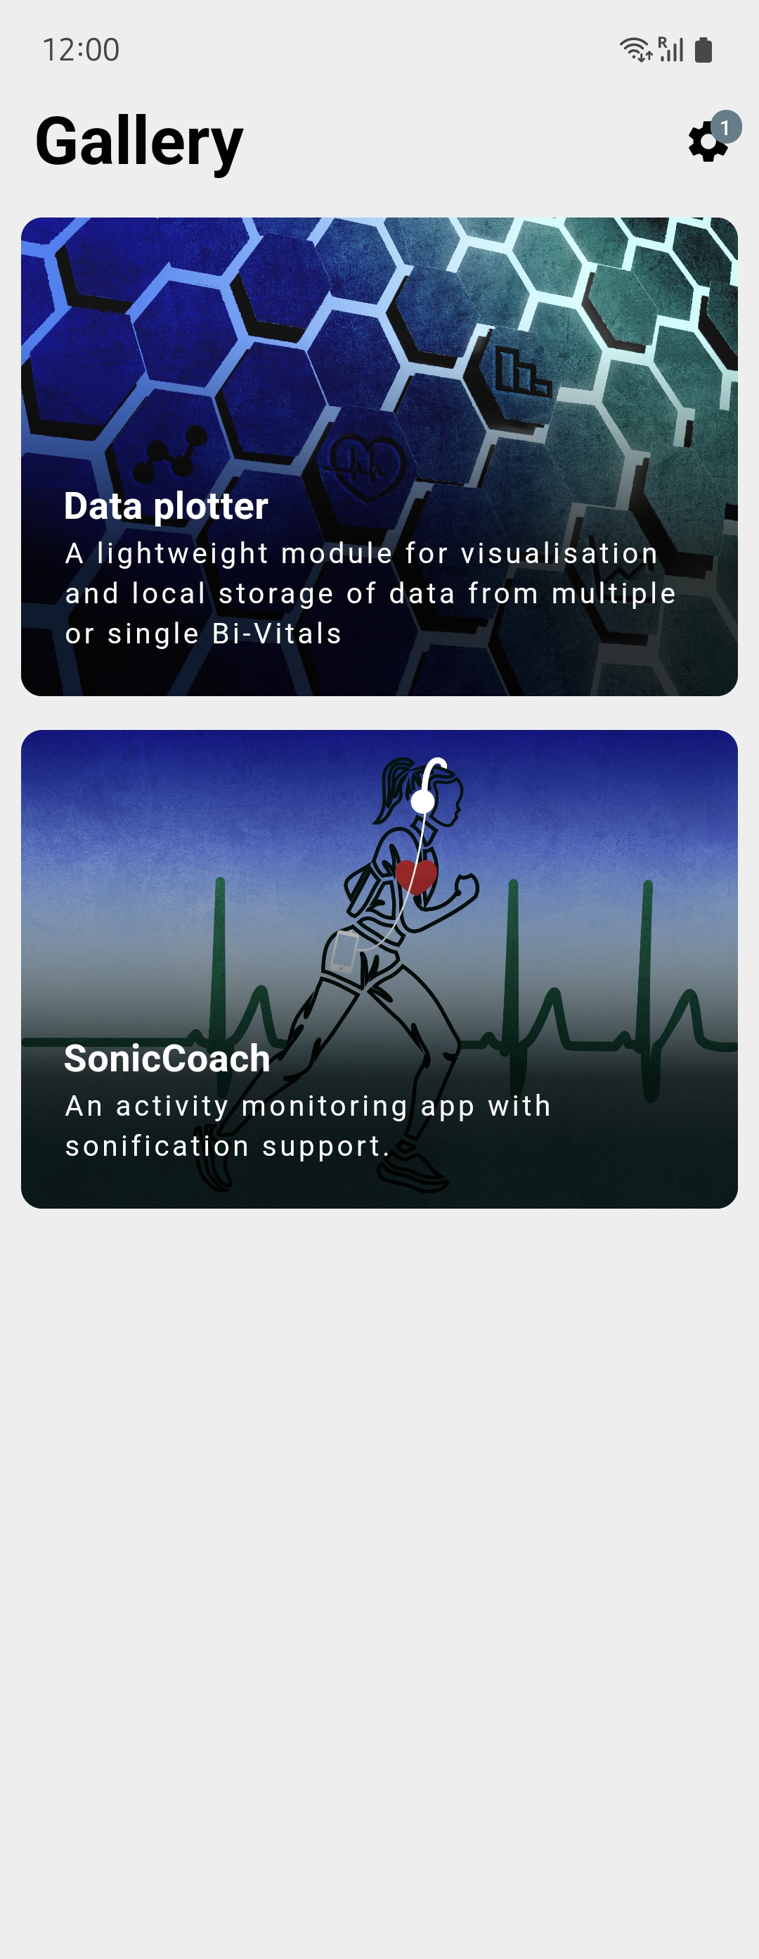


Slide 5


Slide 6
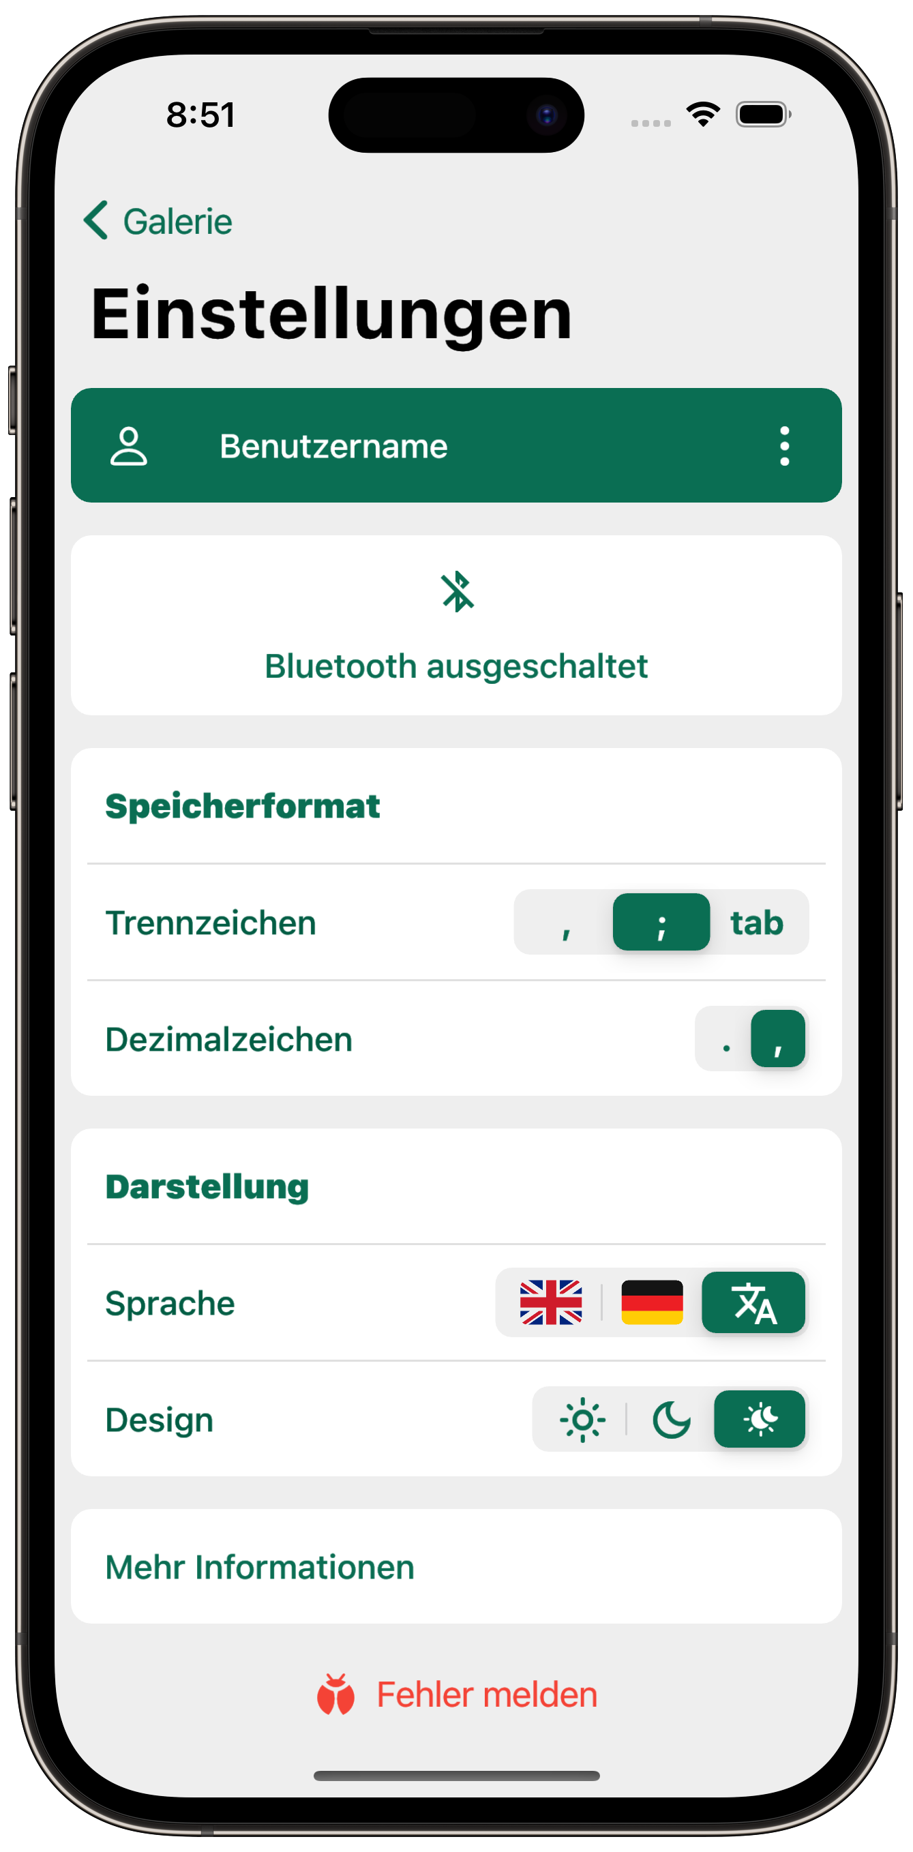
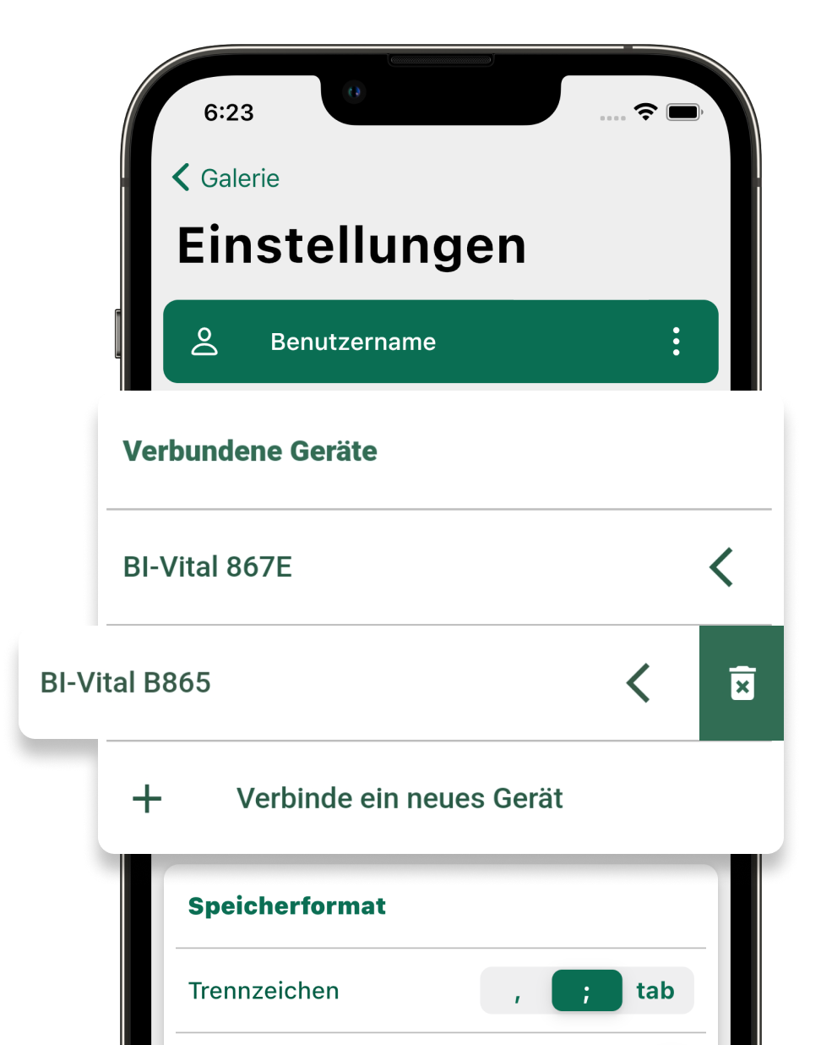
CSV formatting
Change username
Change language and theme
Connect new devices

Slide 7
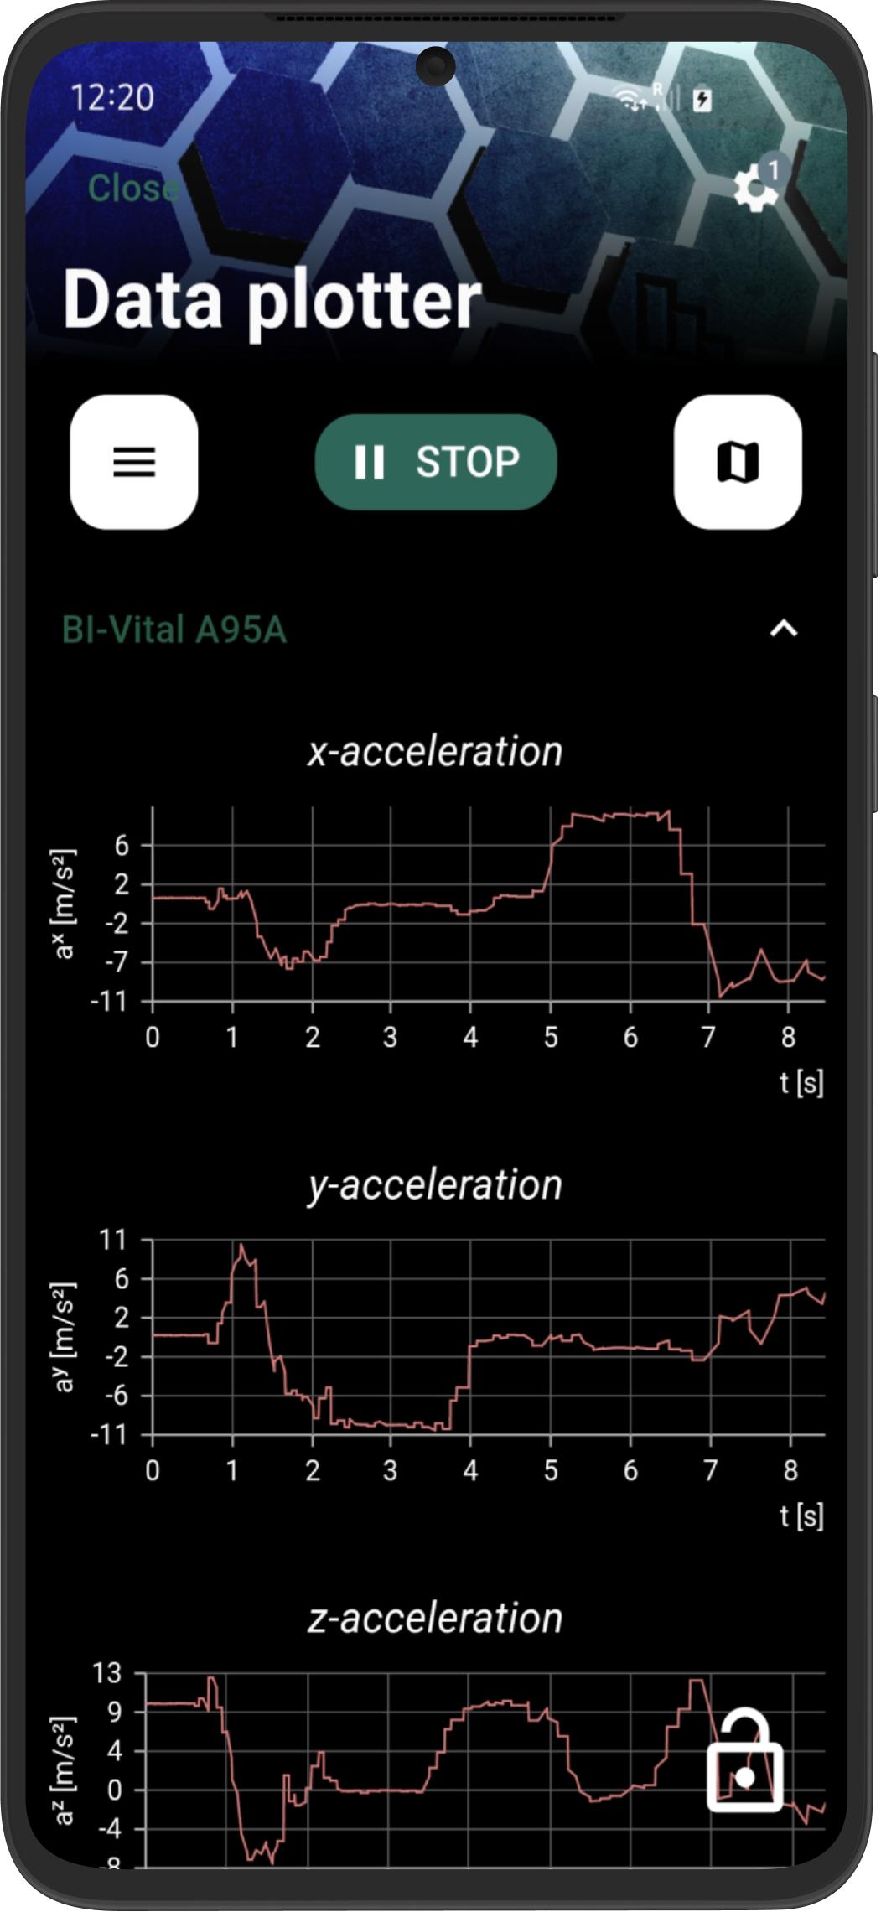
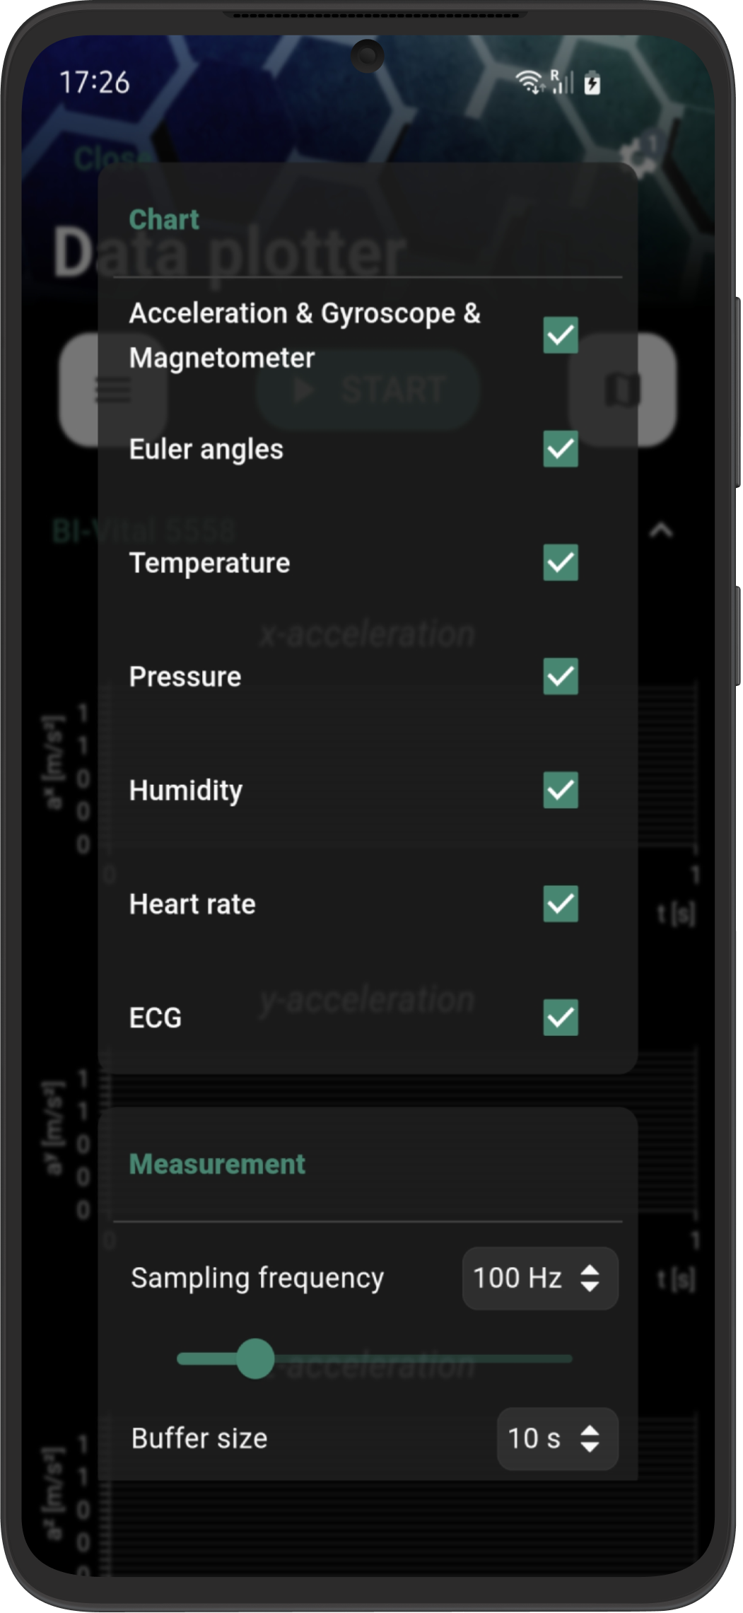

Slide 8
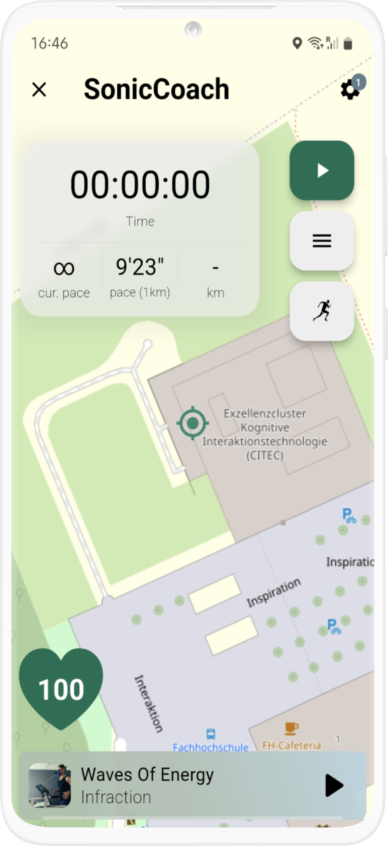

Slide 9

Flutter Software Development Kit
Notes:
https://flutter.dev/showcase

Slide 10
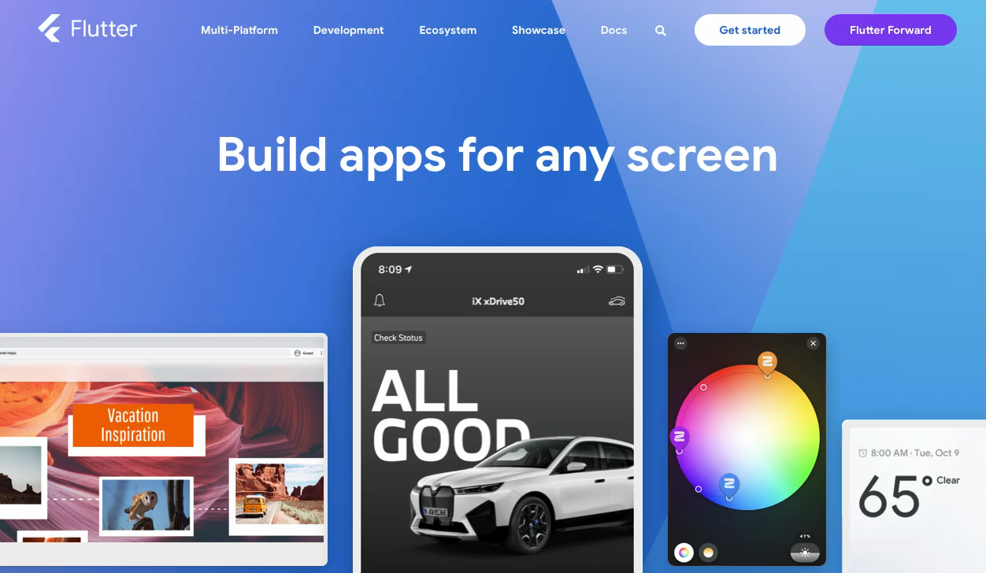

Slide 11
Open-Source
Notes:
Google, but many private people -> up- but also downsides

Slide 12
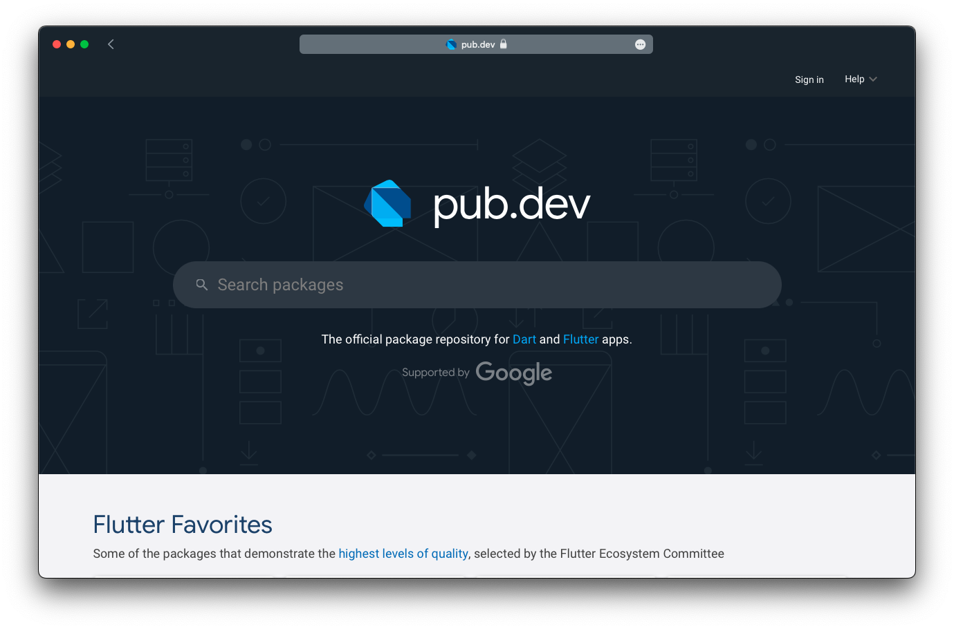

Slide 13
Cross-Platform
Notes:
at compilation --> native code (Kotlin, Swift etc.) --> native performance
control over the entire screen

Slide 14
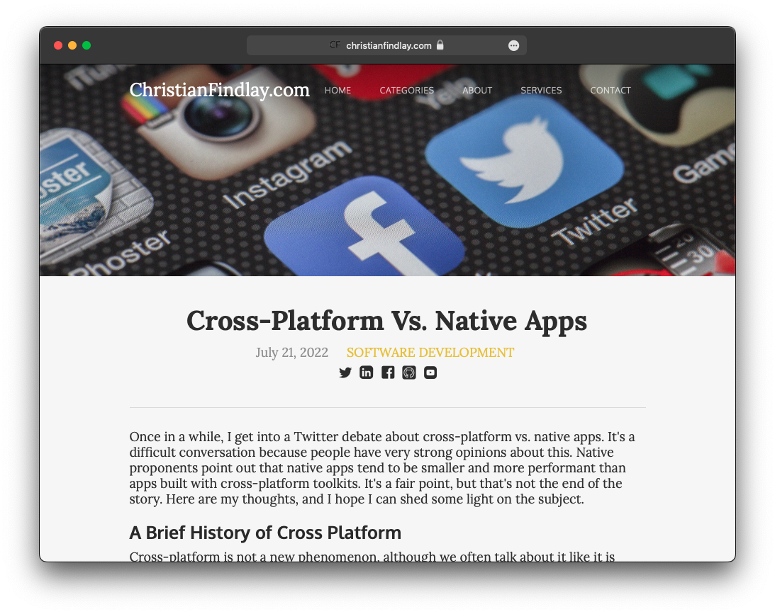
Notes:
https://www.christianfindlay.com/blog/cross-platform-vs-native

Slide 15





HUGE COMMUNITY

Slide 16

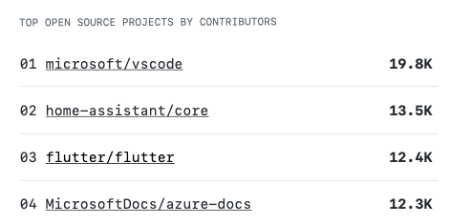
Notes:
2022 war Flutter das drittgrößte Open-Source Projekt, gemessen an der Zahl der Mitwirkenden.

Slide 17


Slide 18
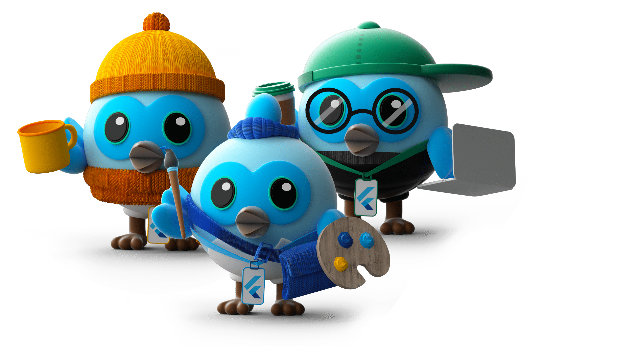
Easy to Learn

Slide 19

Object-oriented
b
Notes:
all objects are instances of classes
but also top-level variables, constants and functions (like in procedural and functional languages)
Everything is Widget

Slide 20
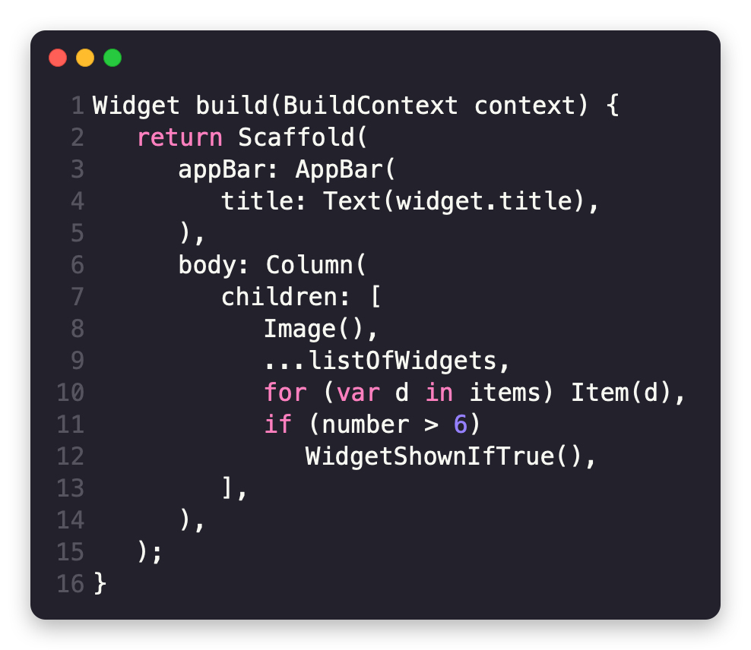
Notes:
dartpad.dev

Slide 21
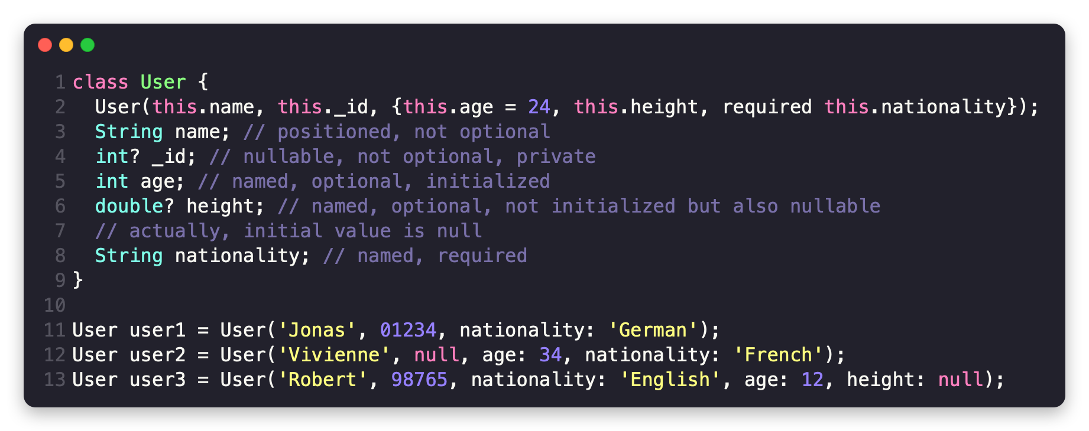
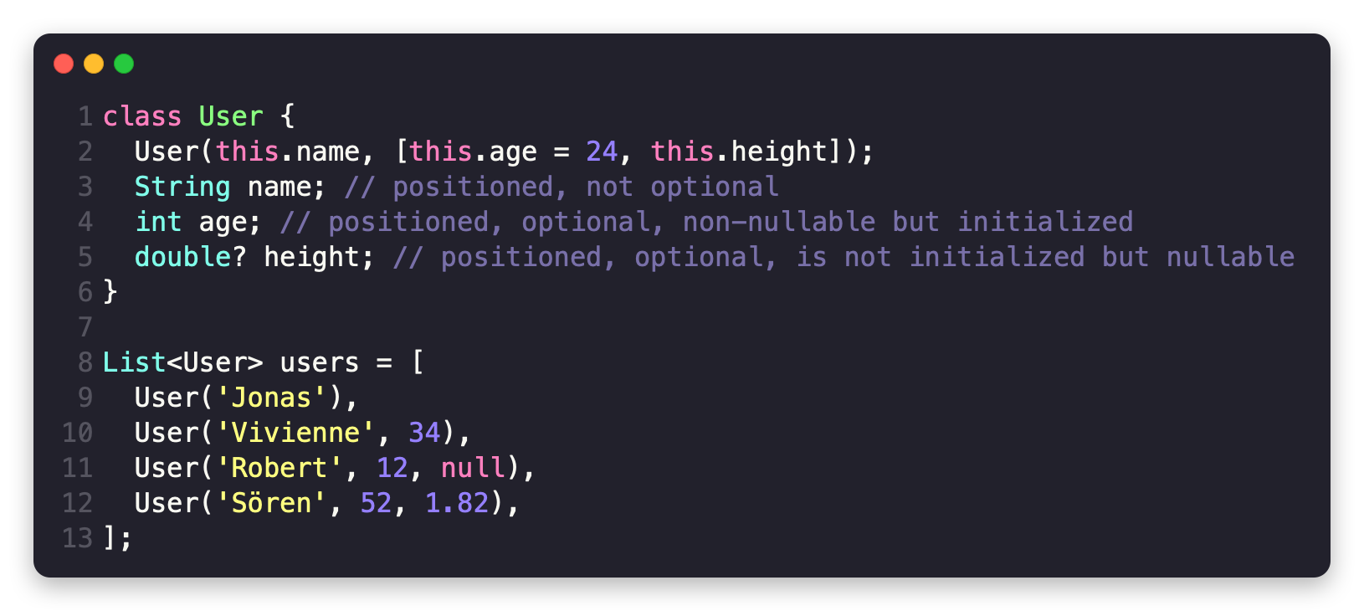
Notes:
all objects are instances of classes
but also top-level variables, constants and functions (like in procedural and functional languages)
Everything is Widget

Slide 22
backend + frontend zusammen
Notes:
(no xml files) --> stateful hot reload + hot restart

Slide 23




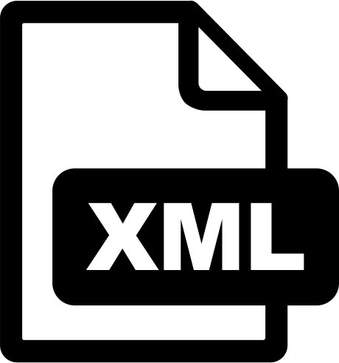









Notes:
(no xml files) --> stateful hot reload + hot restart

Slide 25
Optimized for UI

Slide 26
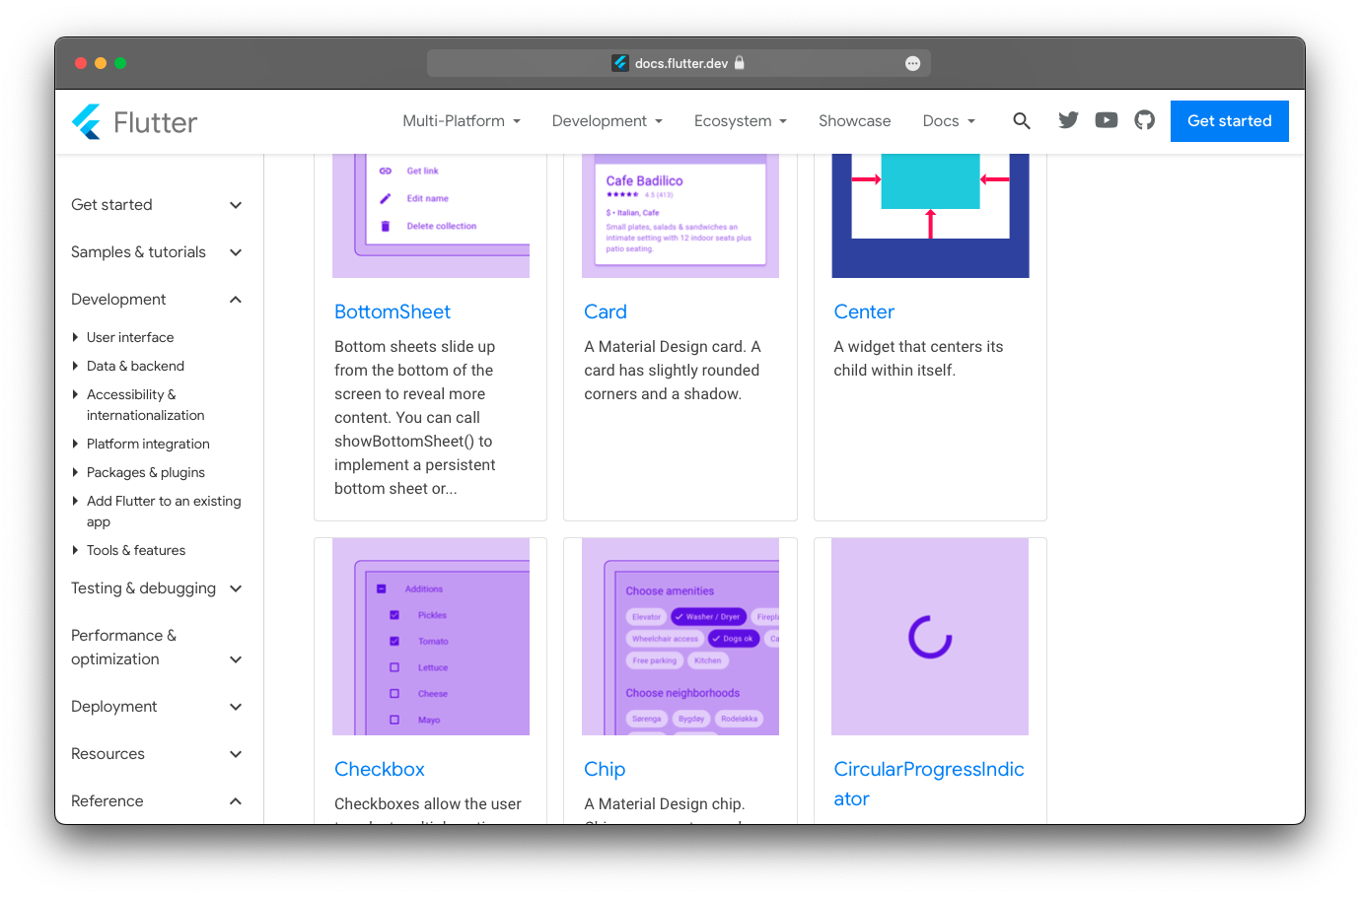

Slide 27

Sound Null Safety

Slide 28
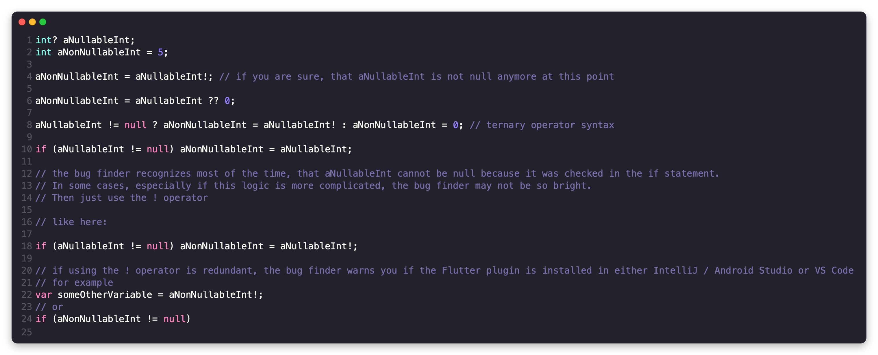

Slide 29
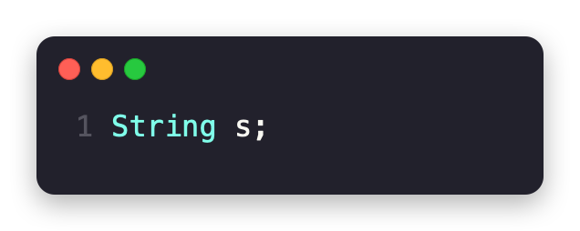

Slide 30
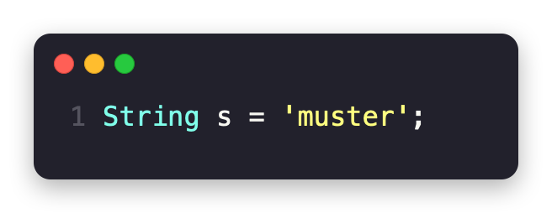

Slide 31
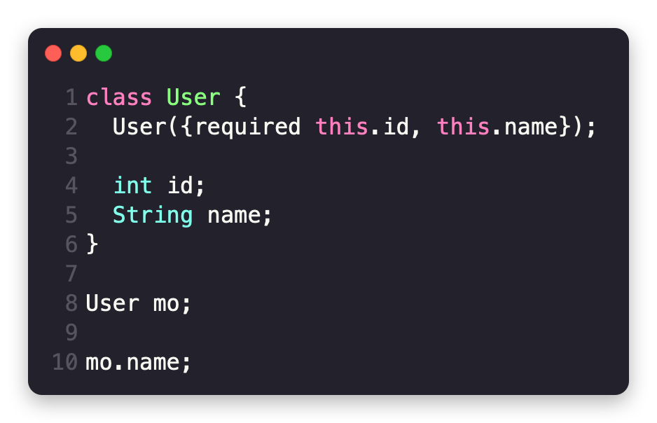

Slide 32
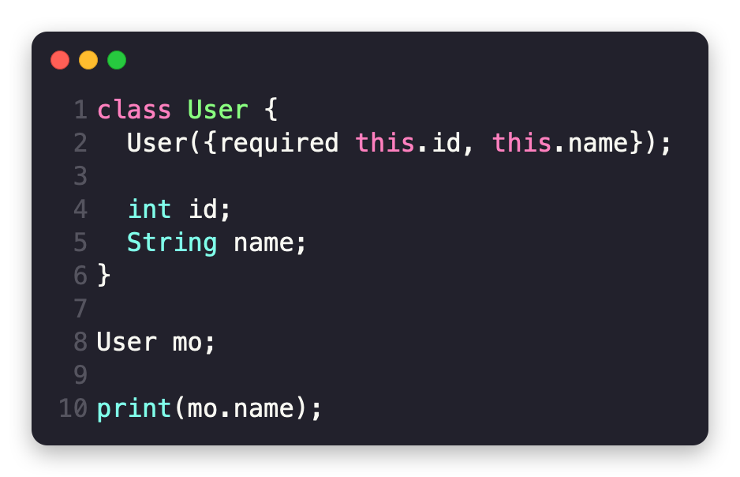

Slide 33



Slide 35
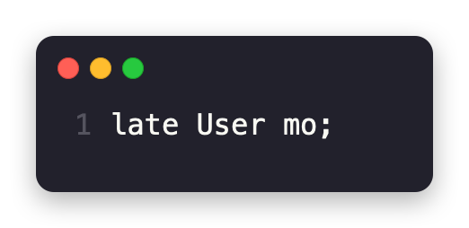
late

Slide 36
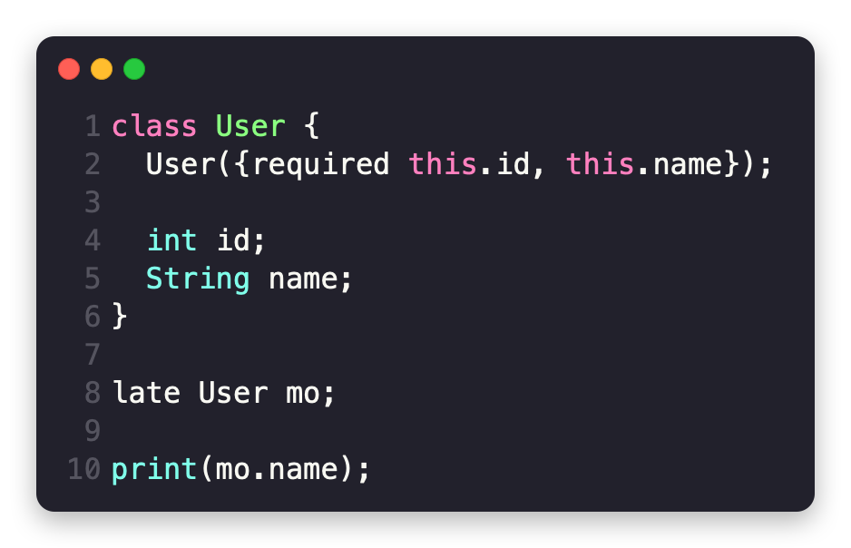
late

Slide 37
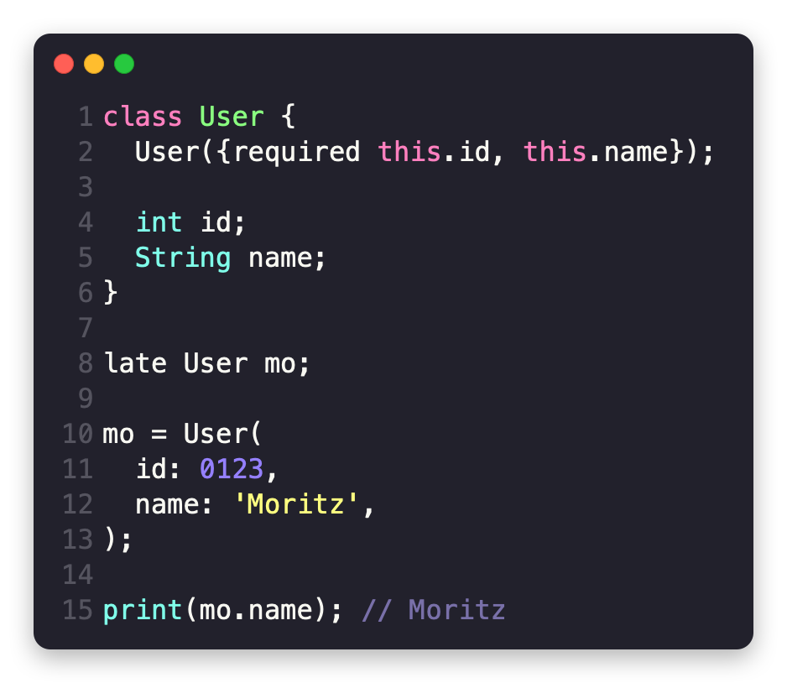

late

Slide 38
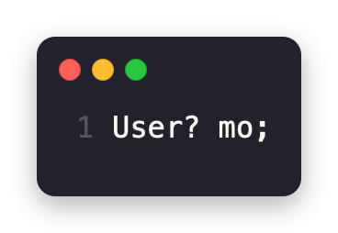
?

Slide 39
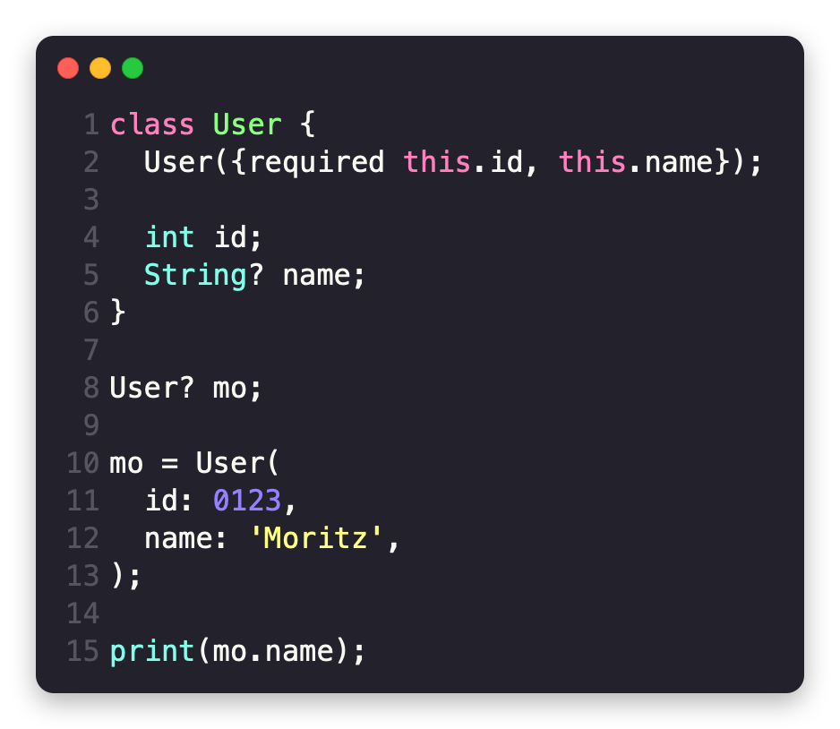
?

Slide 40
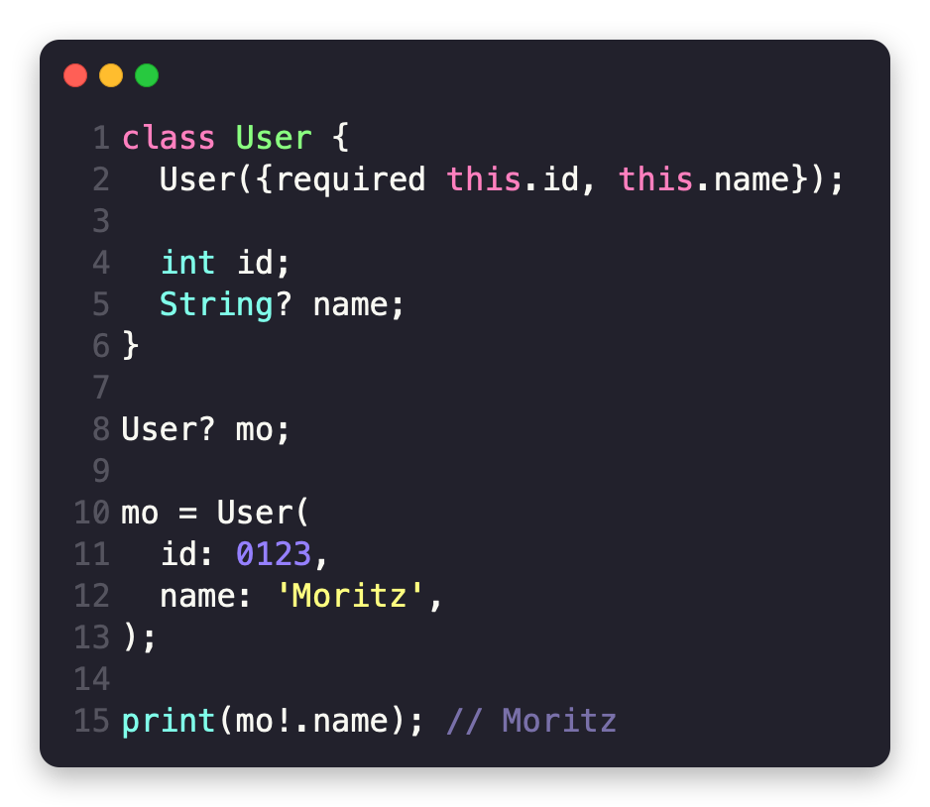
?

Slide 41
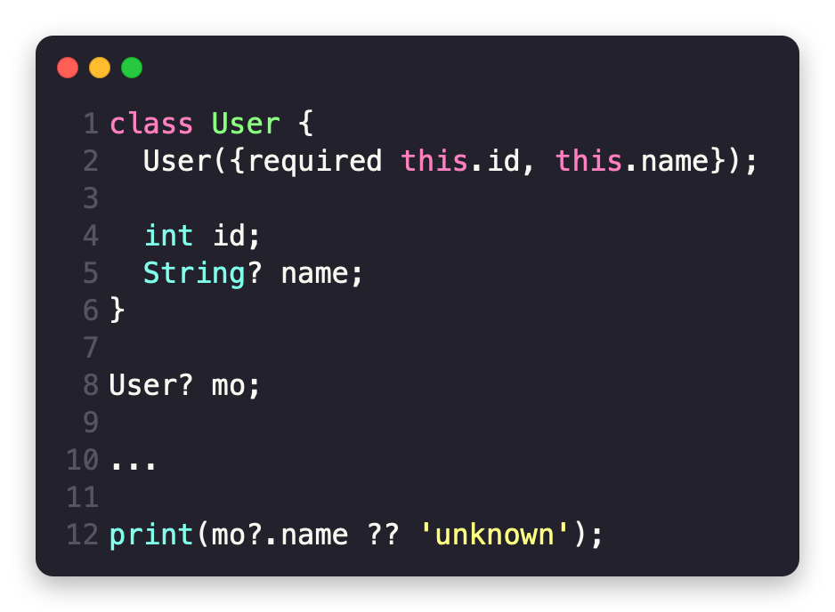
?

Slide 42
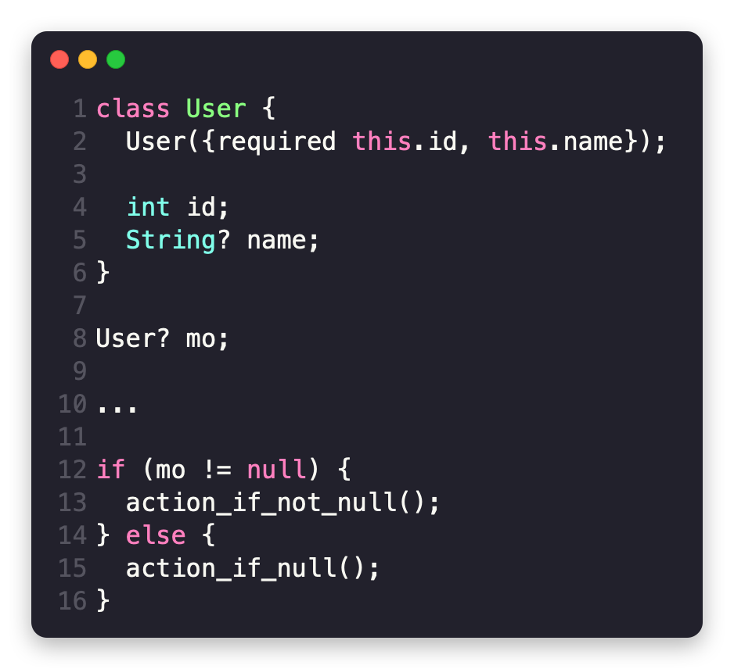

Slide 43
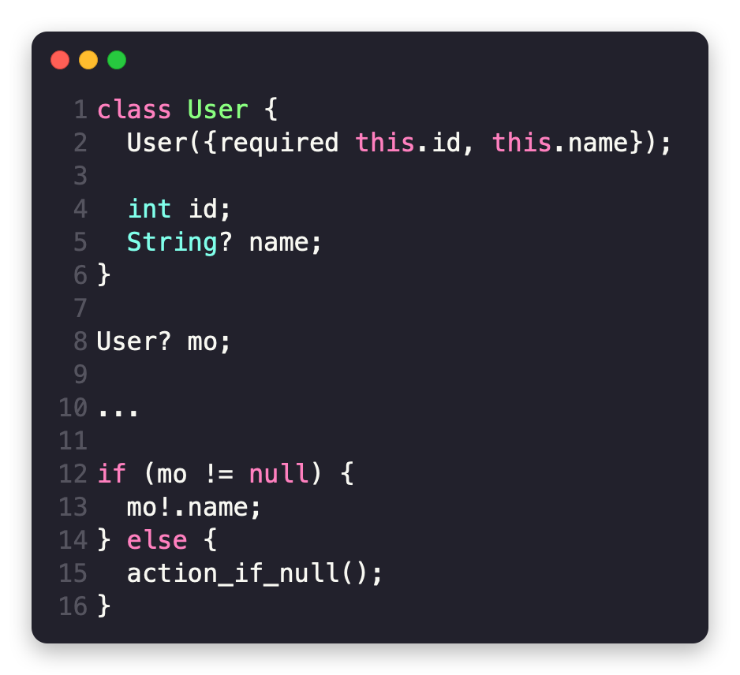

Slide 44
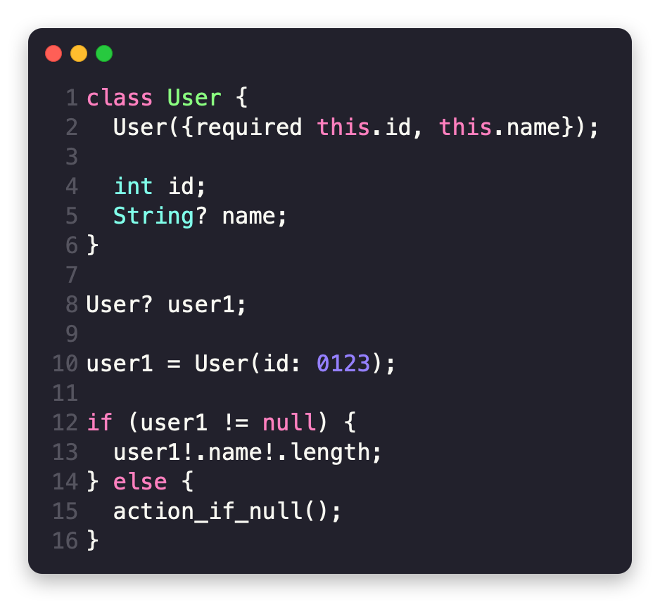

Slide 46
Asynchronous programming
ng
Notes:
async-await + isolate-based concurrency

Slide 47
